Slide 1

Data Science Capstone Project
Predicting the restaurant type for a future business venture in New York

Slide 2
Introduction
The success of any business venture depends on an in-depth study of the market and understanding the business location. Restaurant business survive in areas that are heavily populated, popular or areas with heavy foot traffic. Factors such as the ethnicity of the population can also contribute to the success or failure of a restaurant. This project will analyze the neighborhoods in New York and the type of restaurants that are present in a neighborhood. Using the information from the analyses I will determine the best option for a future restaurant in each neighborhood in New York

Slide 3
Data for the Project
Use the Foursquare API to explore neighborhoods in New York City. Neighbourhood data for New York - https://geo.nyu.edu/catalog/nyu_2451_34572

Slide 4
Methodology
Download and Explore Dataset
Explore Neighborhoods in New York City
Analyze Each Neighborhood
Cluster Neighborhoods
Examine Clusters

Slide 5
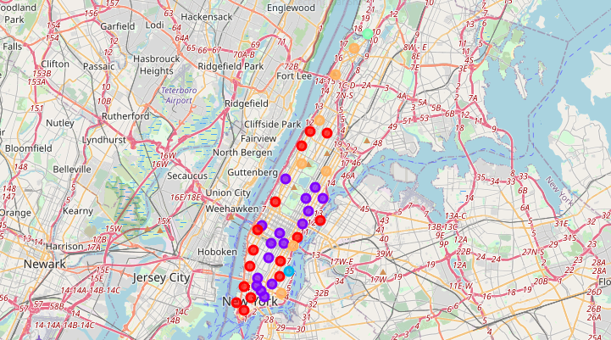
Results
Neighborhoods in Manhattan

Slide 6
Results
The results of this project being extensive, I would like to share a concise set of results based on just Manhattan in New York. Presented below are the results of the analysis of the neighbourhoods of Manhattan. The frequency of venues ----Battery Park City---- venue freq 0 Park 0.11 1 Hotel 0.07 2 Gym 0.05 3 Coffee Shop 0.05 4 Memorial Site 0.04
----Carnegie Hill---- venue freq 0 Coffee Shop 0.08 1 Café 0.04 2 Yoga Studio 0.03 3 Bakery 0.03 4 Cosmetics Shop 0.03
----Central Harlem---- venue freq 0 African Restaurant 0.07 1 American Restaurant 0.05 2 Seafood Restaurant 0.05 3 Bar 0.05 4 French Restaurant 0.05
----Chelsea---- venue freq 0 Coffee Shop 0.08 1 Art Gallery 0.04 2 American Restaurant 0.04 3 Bakery 0.04 4 Italian Restaurant 0.03
----Chinatown---- venue freq 0 Chinese Restaurant 0.08 1 Bakery 0.06 2 Cocktail Bar 0.05 3 Dessert Shop 0.04 4 Vietnamese Restaurant 0.04
----Civic Center---- venue freq 0 Coffee Shop 0.07 1 Cocktail Bar 0.04 2 Hotel 0.04 3 Gym / Fitness Center 0.04 4 Spa 0.03
----Clinton---- venue freq 0 Theater 0.07 1 Gym / Fitness Center 0.05 2 Gym 0.05 3 Sandwich Place 0.04 4 American Restaurant 0.04
----East Harlem---- venue freq 0 Mexican Restaurant 0.12 1 Bakery 0.10 2 Thai Restaurant 0.08 3 Deli / Bodega 0.05 4 Sandwich Place 0.05
----East Village---- venue freq 0 Bar 0.08 1 Pizza Place 0.05 2 Mexican Restaurant 0.05 3 Ice Cream Shop 0.04 4 Cocktail Bar 0.04
----Financial District---- venue freq 0 Coffee Shop 0.11 1 Pizza Place 0.05 2 Cocktail Bar 0.04 3 Gym / Fitness Center 0.03 4 Hotel 0.03
----Flatiron---- venue freq 0 New American Restaurant 0.05 1 Japanese Restaurant 0.04 2 Italian Restaurant 0.04 3 Mediterranean Restaurant 0.04 4 American Restaurant 0.03
----Gramercy---- venue freq 0 Bar 0.07 1 American Restaurant 0.04 2 Italian Restaurant 0.04 3 Coffee Shop 0.04 4 Pizza Place 0.04
----Greenwich Village---- venue freq 0 Italian Restaurant 0.11 1 Clothing Store 0.05 2 Sushi Restaurant 0.05 3 Café 0.04 4 Chinese Restaurant 0.03
----Hamilton Heights---- venue freq 0 Pizza Place 0.08 1 Café 0.07 2 Coffee Shop 0.07 3 Mexican Restaurant 0.05 4 Latin American Restaurant 0.03
----Hudson Yards---- venue freq 0 Gym / Fitness Center 0.07 1 Hotel 0.07 2 American Restaurant 0.07 3 Italian Restaurant 0.05 4 Gym 0.04

Slide 7
Conclusion
The project and the results obtained help us to determine the best option for a new business venture in New york city.The results and analuysis beong too large I have limited the study to just Manhattan and examining cluster. By examining the most common venues and the frequency of the venues we can understand which would be the best option to start a new business venture based on the location.

